Slide 1
From Prediction to Prevention
Machine Learning for Data-Informed Student Retention
By Balram Iyengar, Maneesh Rao & Dhanush
Notes:
“Good morning, everyone. I’m Maneesh, and along with my teammates Balram and Dhanush, we’re presenting our project on Student Dropout Prediction.

Slide 2
Agenda
1
Introduction
2
EDA
3
Models
4
Results & Analysis
5
Takeaway
Notes:
This is the quick outline of the presentation which we will walk you through.

Slide 3
Brief Introduction
Why this topic
Total Records
4424 & 35 features
Impact
Categorical Feature
19
Aim
Numerical Feature
16
Data
Notes:
Before diving into the models, let’s set the stage with some context. School dropout and educational failure are major challenges — not just for students, but for society as a whole. According to the Education Data Initiative, nearly 40% of undergraduate students in the U.S. drop out before completing their degrees. This leads to serious consequences: college dropouts earn about 35% less and face a 20% higher unemployment rate compared to graduates. Institutions also suffer, with lower retention rates impacting funding, rankings, and reputation. We chose this topic because the impact of dropping out is both personal and systemic. It affects career prospects, financial stability, mental health, and educational equity. So, our goal was to build a machine learning classification model that could help predict which students are at risk of dropping out — and more importantly, highlight who needs support the most. Our dataset includes 4,424 student records with 35 features — 19 categorical and 16 numerical. It captures demographic, socioeconomic, and academic data available at enrollment, as well as students’ performance at the end of their first and second semesters. We focused on answering two main core questions: 1) What factors contribute to student dropout, and how do they influence it? 2) And second, which students can we proactively identify and support to help them stay in school?

Slide 5
EDA
1
Label Proportion
2
Categorical feature analysis
3
Numerical feature analysis
Notes:
These are the highlighted areas focused for the presentation.

Slide 6
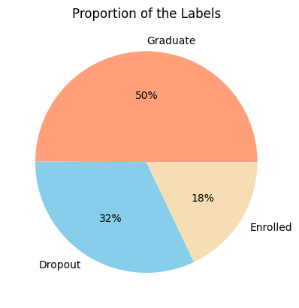
Label Proportion
Notes:
From the pie chart above we can see that the “Target” is imbalanced: with about 50% of the labels are 'Graduate', 32% are 'Dropout', and 18% are 'Enrolled'.
Meaning we will have an imbalanced class labels.

Slide 7
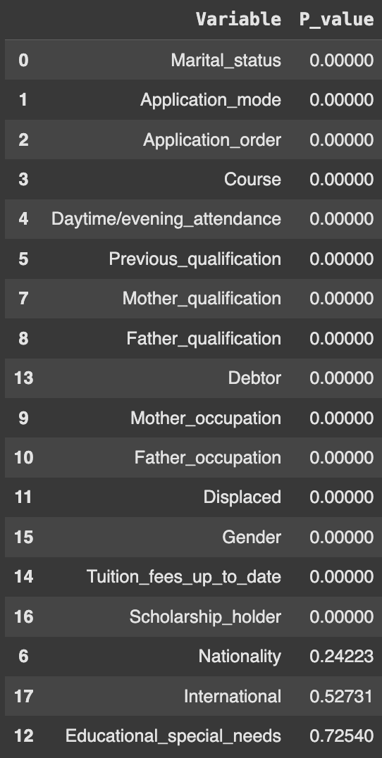
Categorical Feature Analysis
Univariate Analysis - To understand the distribution of each categories through count plots
Bivariate Analysis - Chi-Square Independence test for categorical variables
Notes:
We started looking into each data types respectively.
We looked at the count plots to understand the distribution and chi-square to evaluate the dependence on target variable. The last three categorical variables were removed due to their high value.
—------END—--------
From the count plots some features like Marital Status and Attendance were heavily imbalanced. Others, like Application Mode and Course, shows good variety. Parental background has many categories and binary features like Debtor and Tuition Fees could be strong predictors despite their imbalance.
We used the Chi-Square test to evaluate the dependence of categorical features on the target variable.
Most of the p-values are close to zero, except for three variables ('Nationality', 'International', 'Educational_special_needs') with very high p-values (0.24, 0.53, 0.73), indicating that no statistically significant association between these three features and the label. We removed them from modeling.
Since this test is only applicable to categorical variables, we now proceed to explore the numerical features using appropriate techniques.

Slide 8
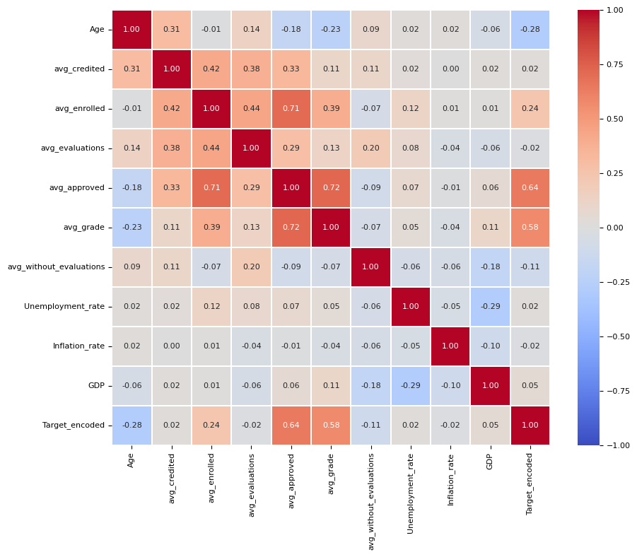
Numerical Feature Analysis
Univariate Analysis - Histogram to visualize the distribution of numerical feature
Bivariate Analysis - Spearman’s rank correlation between numerical features and the target
Notes:
The correlation matrix showed that 'curri_avg_approved' and 'curri_avg_grade' still have a relatively high correlation with the labels ('Target_encoded'), while 'curri_avg_credited' and 'curri_avg_evaluations', along with 'the macroeconomic data ('Unemployment_rate', 'Inflation_rate'), have very low correlations, all between -0.02 and 0.02. We excluded these four features.

Slide 9
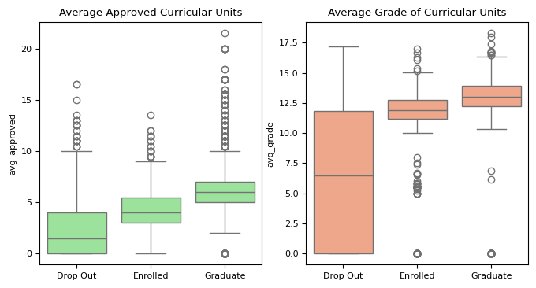
Numerical Feature Analysis
Notes:
We checked how 'curri_avg_approved' and 'curri_avg_grade' are associated with students' situation at the end of the normal duration of the course by plotting the box plot and It was not surprising that 'Graduate' is associated with more approved curricular units and higher grades. However, there are some instances of a 0 value for average grade and average approved curricular units in the 'Graduate' class.
We found 75 data points where all data related to curricular units is zero, yet the students are labeled as 'Graduate.' This contradicts common sense, We treated these rows as outliers and removed them from the dataset.
With this our understanding of the dataset was good enough to start building the model!

Slide 10
Models
1
1st Iteration
2
2nd Iteration
3
3rd Iteration
Notes:
We have done 3 iterations of models.

Slide 11
Models
1
1st Iteration
21 features
3 targets
Random Forest
XGBoost
Voting Classifier
Notes:
In first iteration we retained most relevant 21 features we found through EDA.
We have built random forest and XGBoost model which are best suited for classification models when the classes are imbalanced.
Features like in-built feature importance calculations make them easy and simple to use.
To have robust, more accurate prediction we used Voting Classifier, which combines the strengths of both Random Forest and XGBoost by averaging their predicted probabilities, leading to improved generalization and stability in our results.

Slide 12
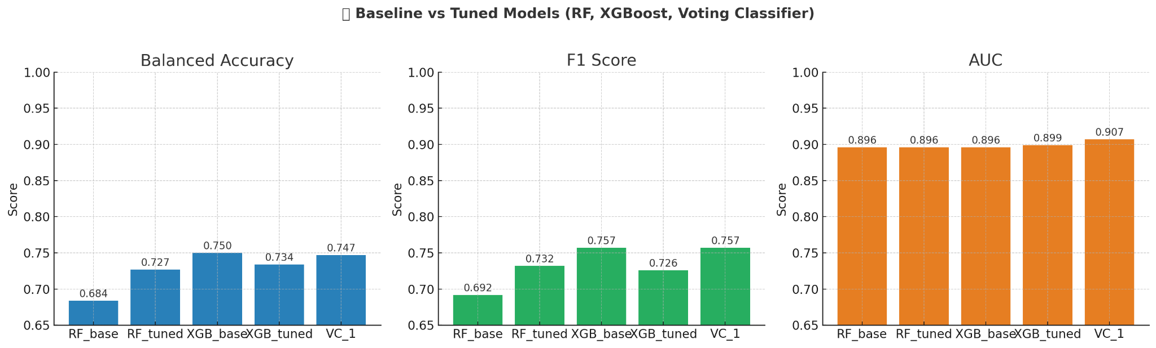
Random Forest
VotingClassifier
XGBoost
Notes:
In Iterations 1 and 2, we built and tuned models, then combined them using a Voting Classifier. XGBoost and the Voting Classifier showed the best performance, with very close scores. AUC was consistently high across models, which might suggest some difficulty in predicting one of the classes accurately.
Let's look into confusion matrix of 'xgb_base' and understand better.

Slide 13
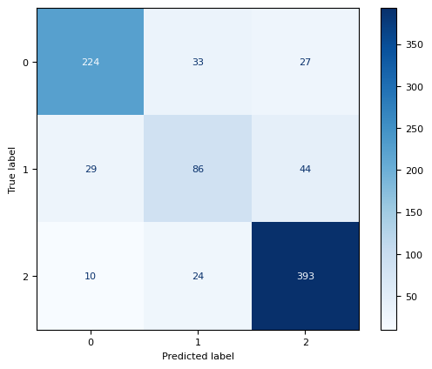
Confusion Matrix
Notes:
The model performs well in distinguishing between Dropout (0) and Graduate (2). However, it struggles more with Enrolled (1), which makes sense—Enrolled is an intermediate state that could lead to either dropout or graduation. This overlap likely introduces ambiguity and affects the model's ability to classify it accurately.

Slide 14
Models
2
2nd Iteration
21 features
2 targets
Random Forest
XGBoost
Voting Classifier
Notes:
In second iteration we decided to drop the “enrolled” target and retaining the same number of features.

Slide 15
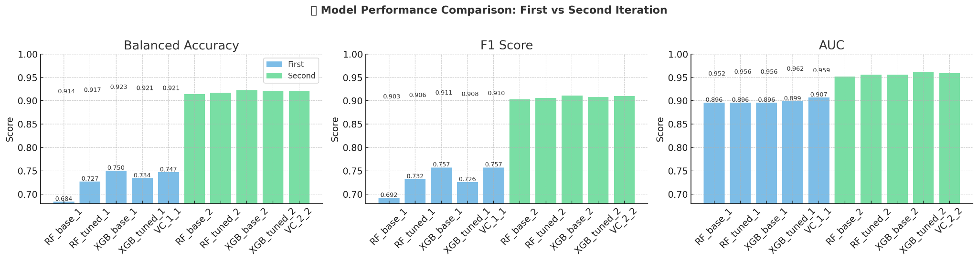
Random Forest
VotingClassifier
XGBoost
Notes:
The performance of the five binary classification models is much better than all 3-classes models before.
'XGB_base' and 'VotingClassifier' performs better than the other models again, and their performances are also very close: 'XGB_base' performs slightly better than 'VotingClassifier' in terms of balanced accuracy and F1 score, but it's AUC is a bit lower than that of 'VotingClassifier'.

Slide 16
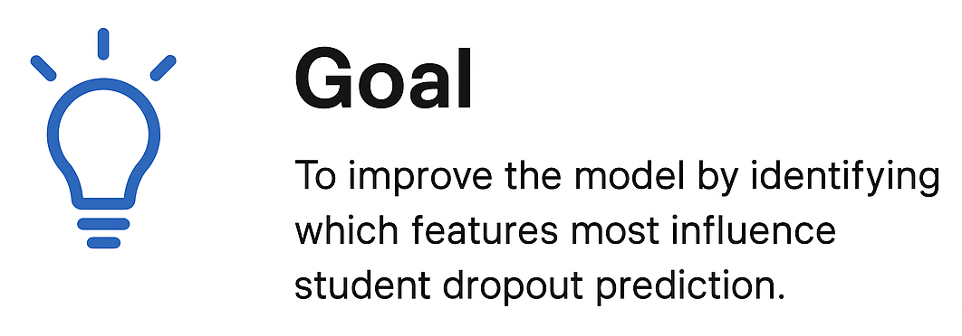
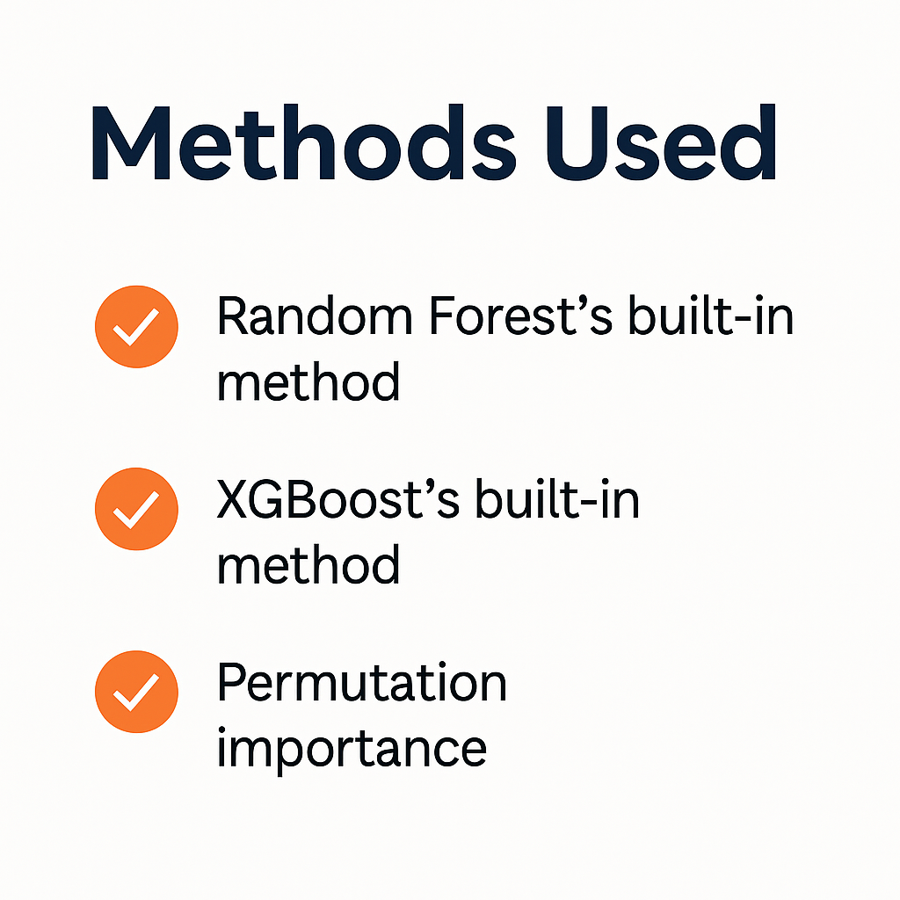
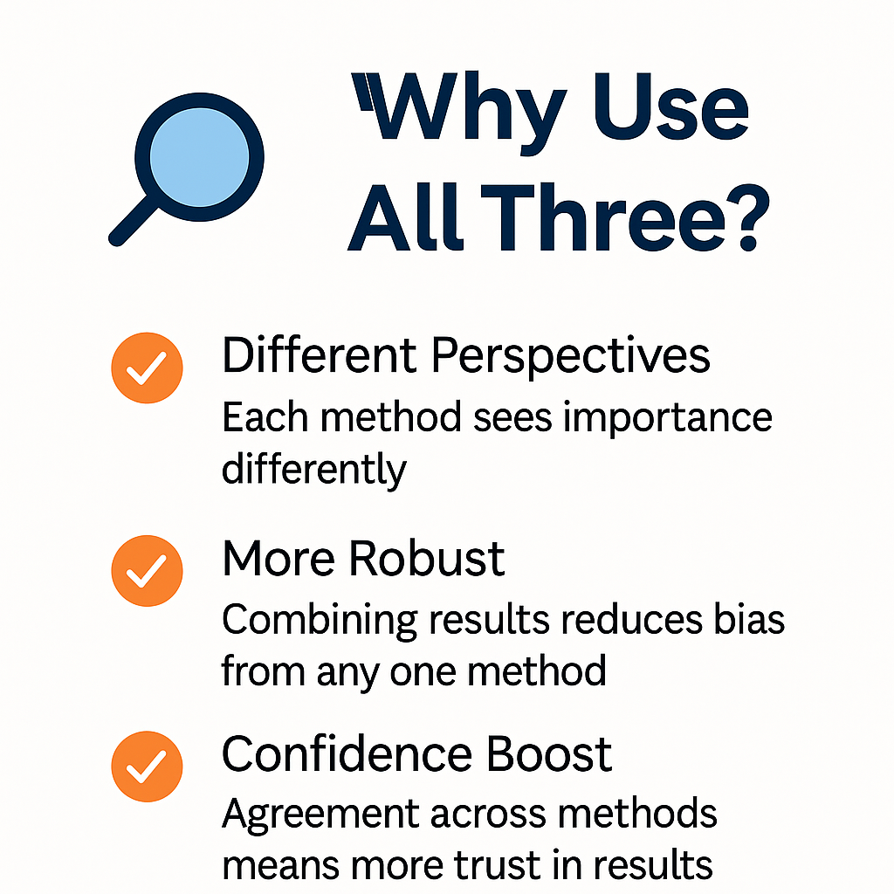
Feature Importance
Notes:
To further improve the model I wanted to understand which features had the biggest impact on predicting student dropout, so I used three different methods to calculate feature importance:
Random Forest’s built-in method
XGBoost’s built-in method
Permutation importance, which works by shuffling each feature and measuring how much the model’s performance drops."
Each method gives a slightly different perspective, so combining them makes the results more reliable. If all three agree a feature is important, we can be more confident it's really meaningful."
Once I had all three scores, I averaged them for each feature to get a single, balanced importance score. Then I sorted the features and calculated how much of the total importance each one contributed.

Slide 17
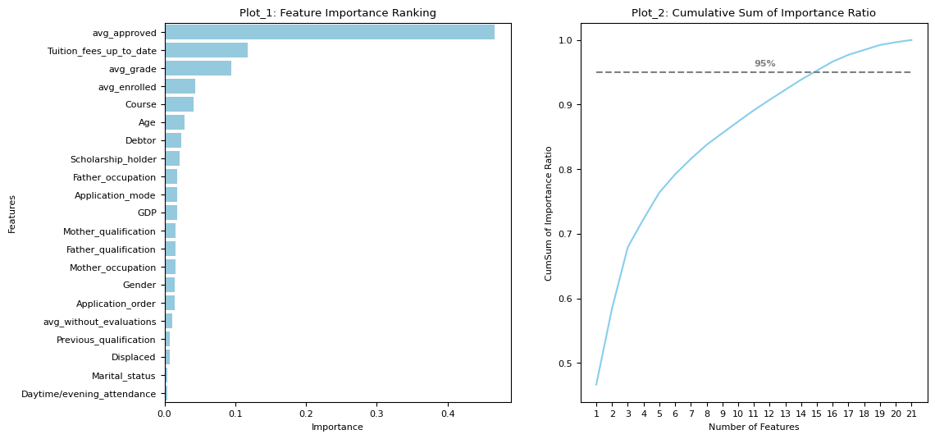
Feature Importance - Result
Notes:
In this graph, you can see two plots. The first one ranks all the features by their importance, and the second one shows how that importance adds up across the features. What stands out is that not all features are equally important—some contribute very little to the model.
If you look at the dashed line in the second plot, it marks the point where the cumulative importance reaches 95%. This happens by the 15th feature. Interestingly, the 15th feature is 'Gender', and its score is almost the same as the next one, 'Application_order', meaning both have nearly equal importance.
So to keep the model efficient without losing predictive power, I’m choosing to keep the top 16 features and remove the rest before retraining.

Slide 18
Models
3
3rd Iteration
16 features
2 targets
Random Forest
XGBoost
Voting Classifier
Notes:
Last Iteration with 16 features and 2 targets.

Slide 19
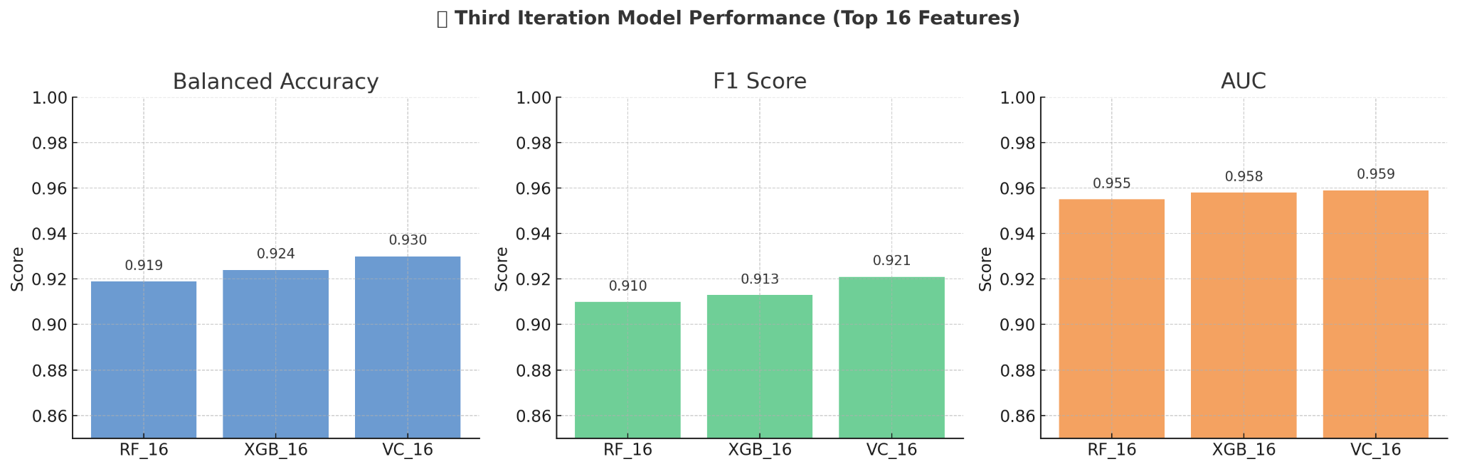
Random Forest
XGBoost
Notes:
The Voting Classifier 'vc_b16' achieved a balanced accuracy of 0.93, an F1 score of 0.921 and an AUC score of 0.959, making it the best model among all those we've built.

Slide 20
Results & Analysis
1
Model Performance
2
Top Features in Final Model
3
Conclusion
Notes:
Let’s look into the results & analysis

Slide 21
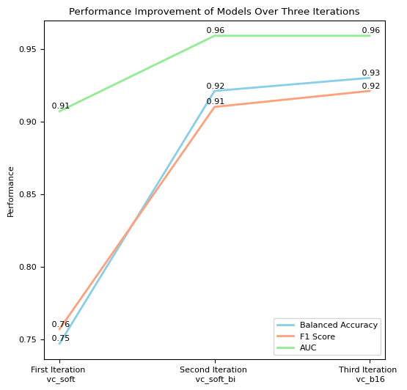
Model Performance
Notes:
Across three iterations, with evolving class numbers (from 3 to binary) and feature sets (from 21 to 16), model performance improved significantly. Balanced accuracy jumped from 0.75 to 0.93 (an increase of 24%), F1-score rose from 0.76 to 0.92 (an increase of 21%), and AUC increased from 0.91 to 0.96 (an increase of 5%), indicating substantial gains in classification accuracy.

Slide 22
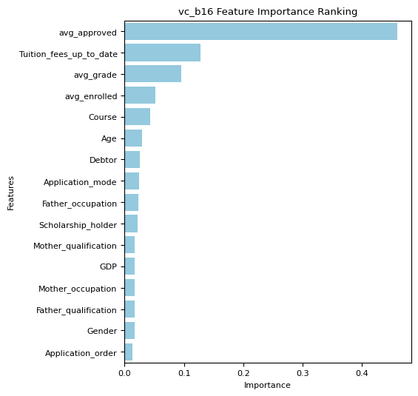
Top Features in Final Model
Notes:
The most important features are 'curri_avg_approved,' 'Tuition_fees_up_to_date,' and 'curri_avg_grade,' followed by 'curri_avg_enrolled,' 'Course,' and 'Age'. Among these top features, four are academic data, one is socioeconomic data, and one is demographic data.

Slide 23
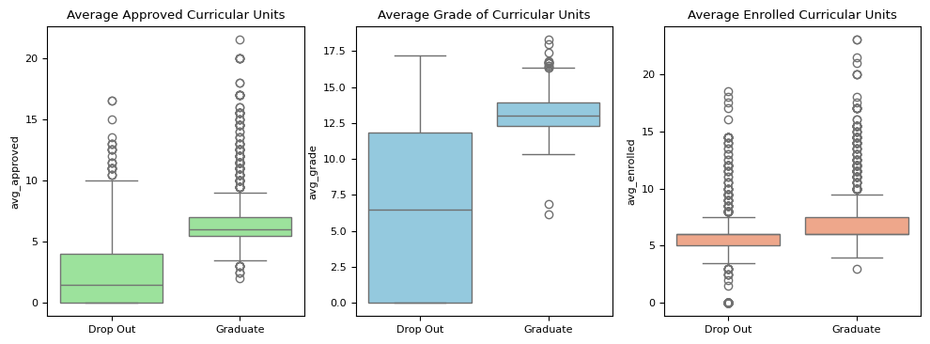
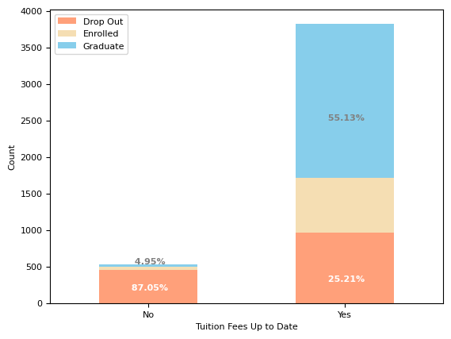
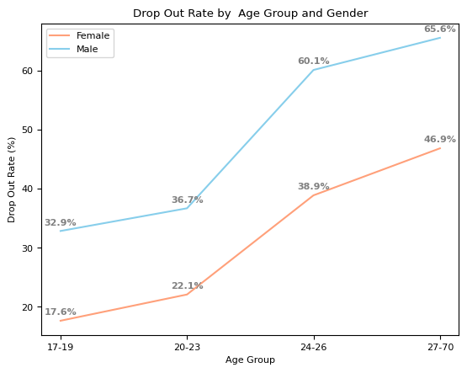
Top Features in Final Model
Notes:
Let's see how these features influence whether students drop out or graduate.
**ADD POINTS FOR BOXPLOT**
Students whose tuition fees are not up to date have a very high dropout rate of 87.05% and a very low graduation rate of 4.95%.
The 'Age' variable ranges from 17 to 70 in the dataset. Divided it into four age groups and then visualize the dropout rate by age group and gender.
The dropout rates of both females and males increase with age, but females consistently have lower dropout rates across all age groups, suggesting that both age and gender are important factors influencing students' likelihood of dropping out.

Slide 24
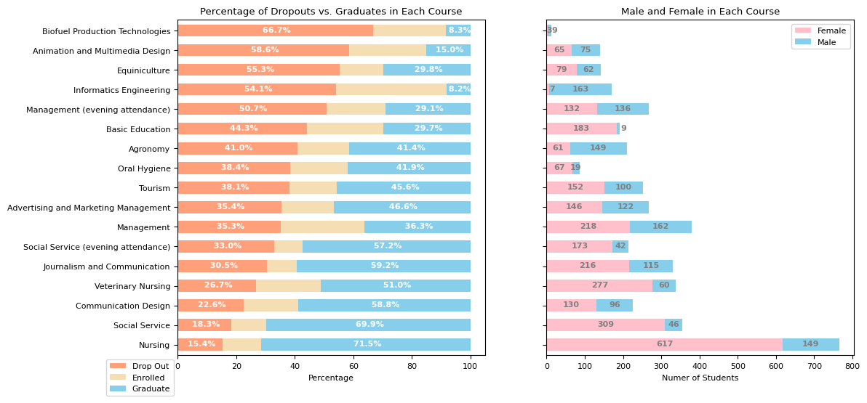
Top Features in Final Model
Notes:
The dropout rates in different courses range from 15.4% to 66.7%. Five out of 17 courses have dropout rates exceeding 50%.
In this dataset, there are more females than males, resulting in a predominance of female students in most courses. While enrollments vary across different courses, the proportions of female and male students also differ, suggesting that factors beyond gender contribute to dropout rates.

Slide 25
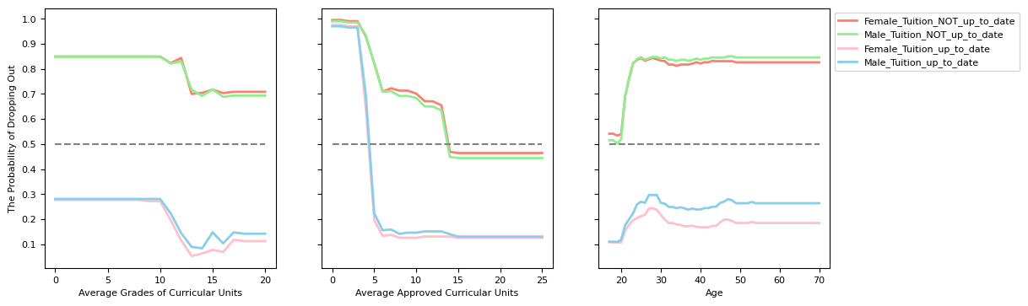
Top Features in Final Model
Notes:
To better understand the impact of key factors on dropout risk, I created three simulated datasets—one each for average grade, approved courses, and age. In each case, I held all other features constant and systematically varied the target variable to isolate its effect on dropout probability.
The probability of dropping out based on the three simulated datasets shows that 'Tuition_fees_up_to_date' plays a vital role in our final model: students whose tuition fees are NOT up to date have a significantly higher dropout probability, consistently exceeding 0.5 in most simulated scenarios.
This raises another question: does a student not paying tuition on time strongly indicate that they are likely to drop out, or does the university deregister students from their courses when they have not paid all the required tuition fees by the specified deadlines? Probably both. But this is beyond our analysis.

Slide 26
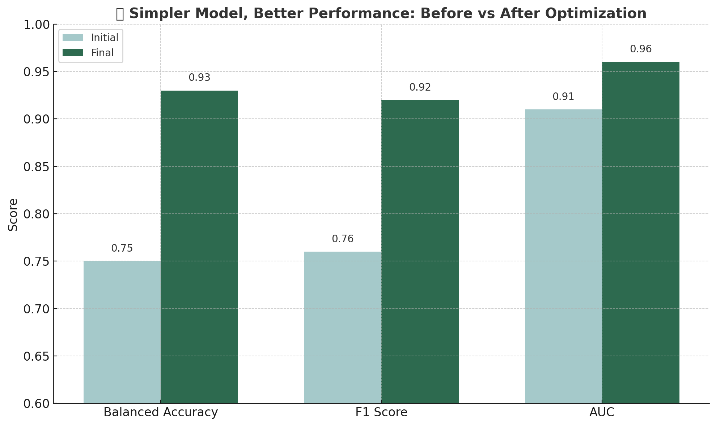
Conclusion
Notes:
Across three iterations of modeling, model complexity was reduced, from 21 features to 16 features and from three-class to binary classification, while model performance improved significantly:
Balanced Accuracy jumped from 0.75 to 0.93 (an increase of 24%)
F1 Score rose from 0.76 to 0.92 (an increase of 21%)
AUC increased from 0.91 to 0.96 (an increase of 5%)
From these three iterations, I learned that removing noise -- such as insignificant features and the transitional class ('Enrolled,' in this case, which can transition to 'Dropout' or 'Graduate') -- not only reduces model complexity but also significantly improves model performance, resulting in a simpler and more accurate model.

